Slide 1
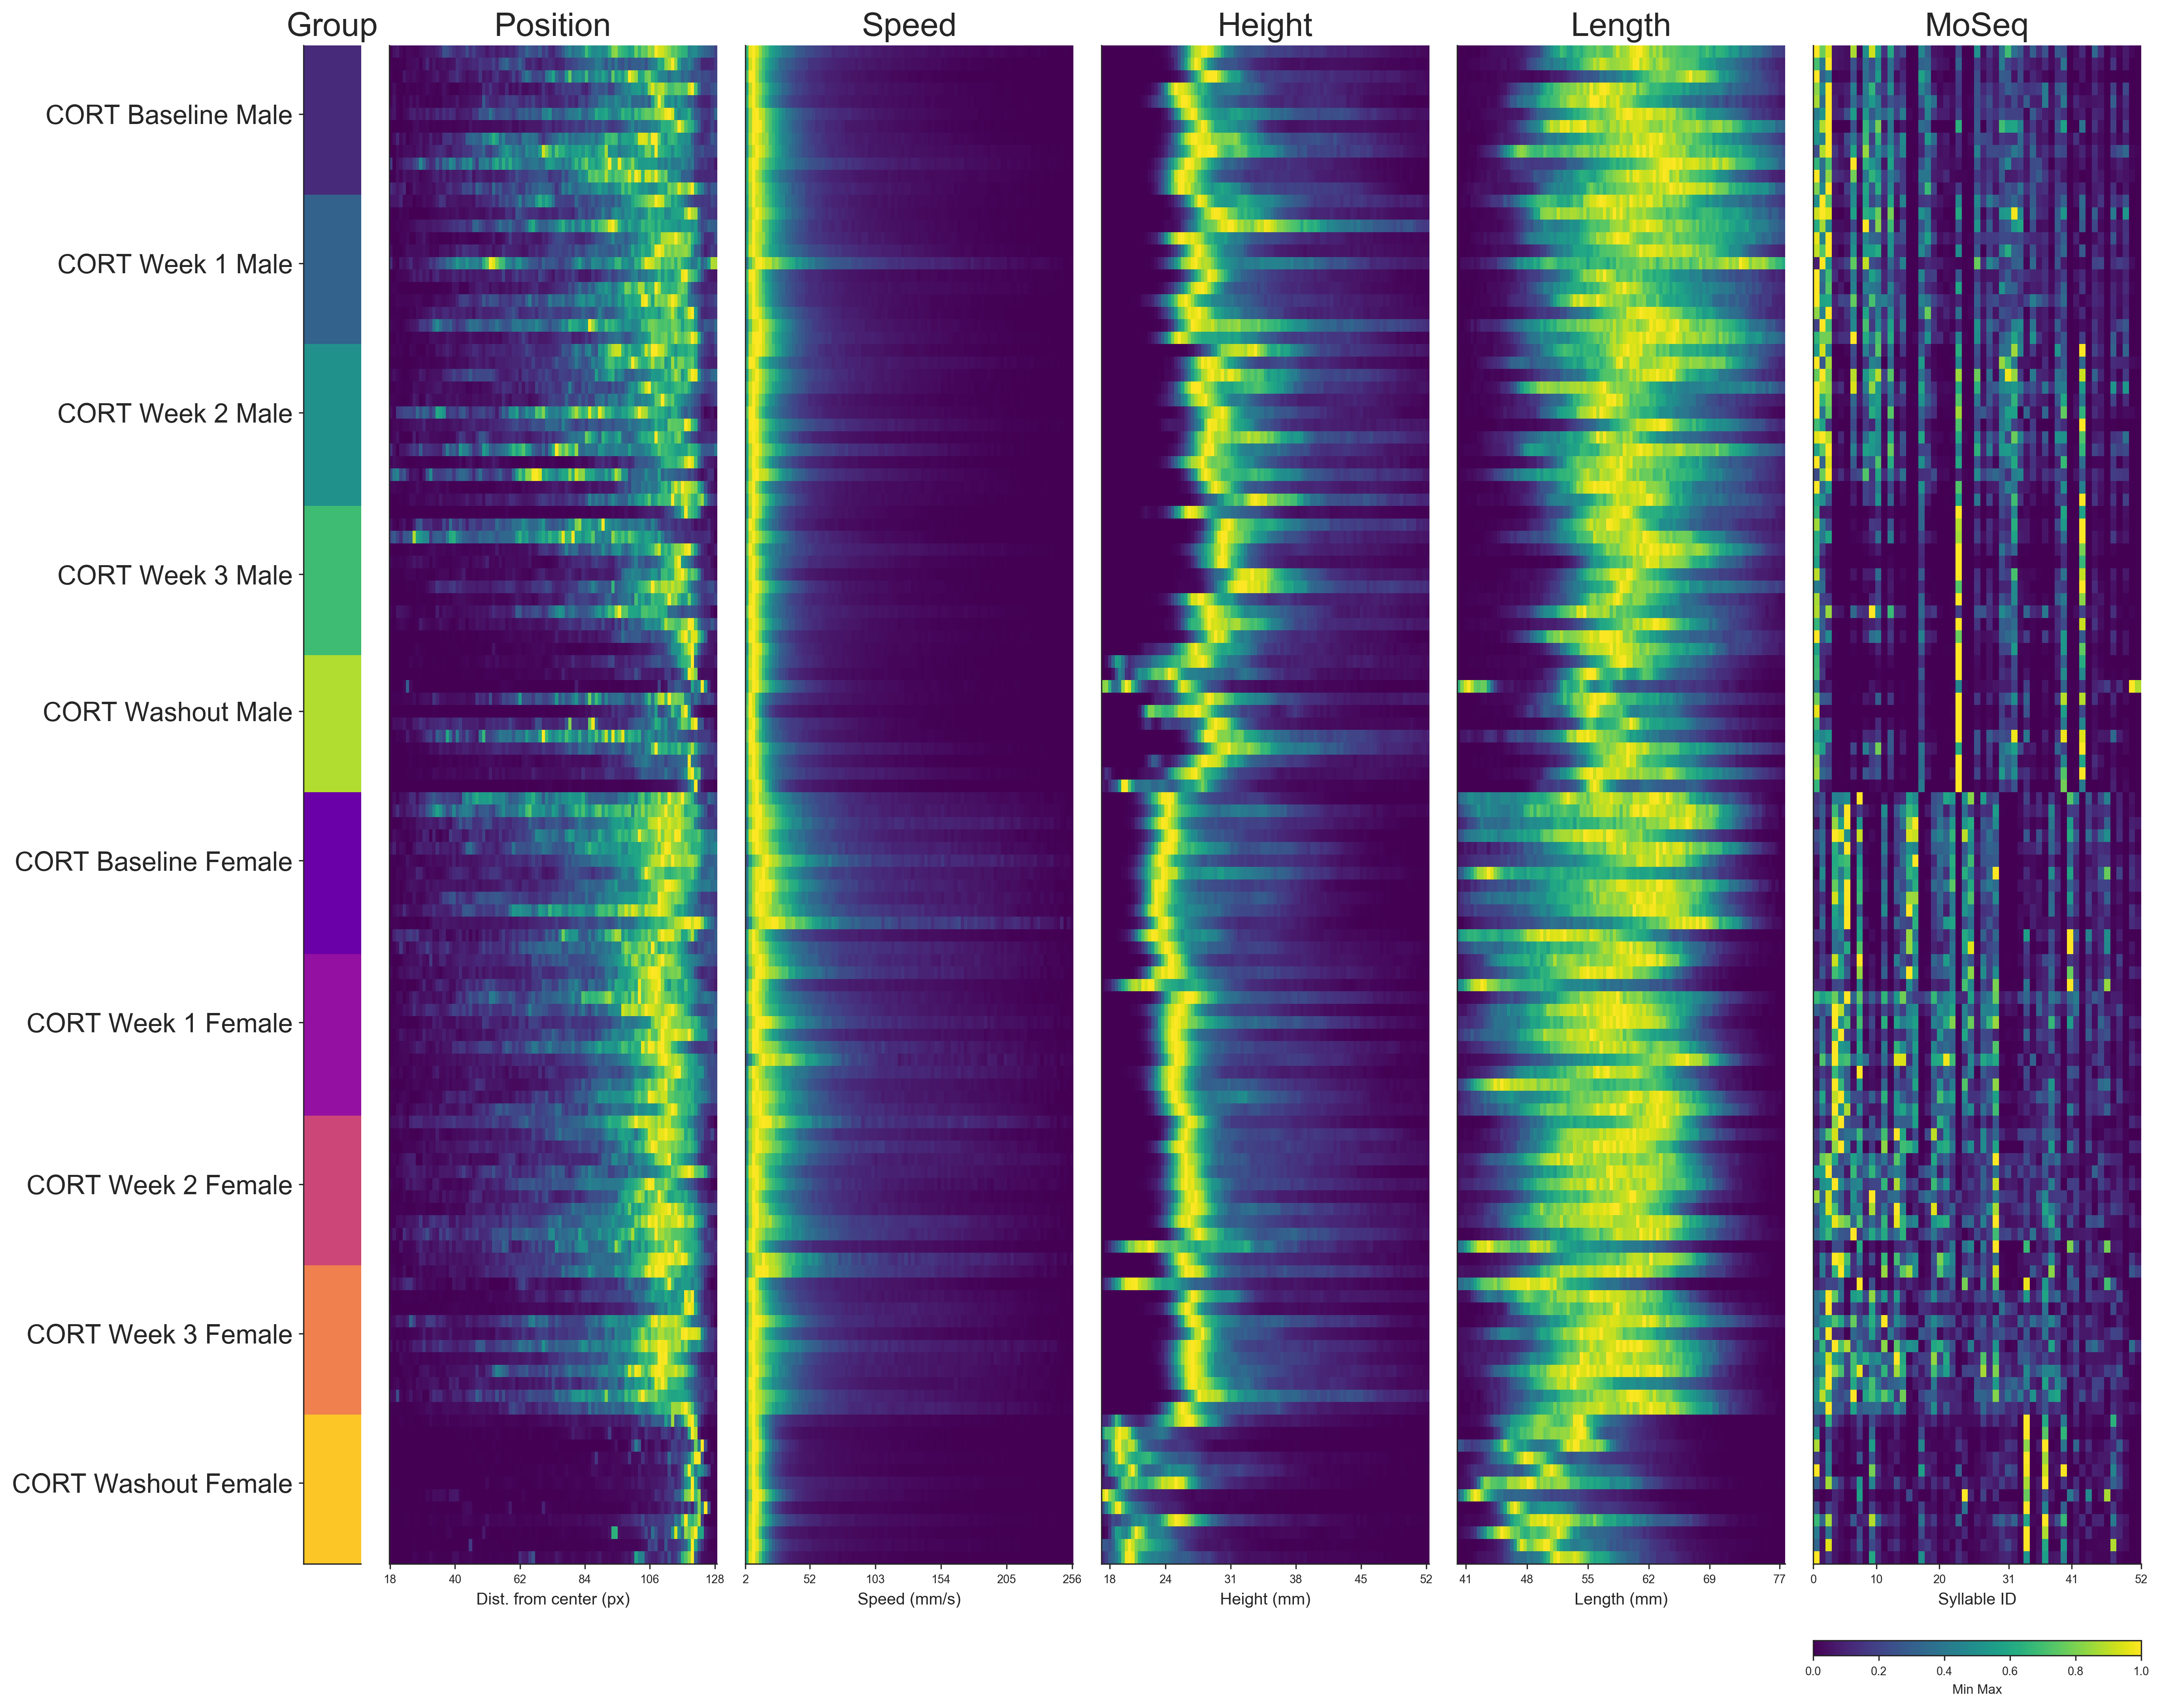

Slide 2
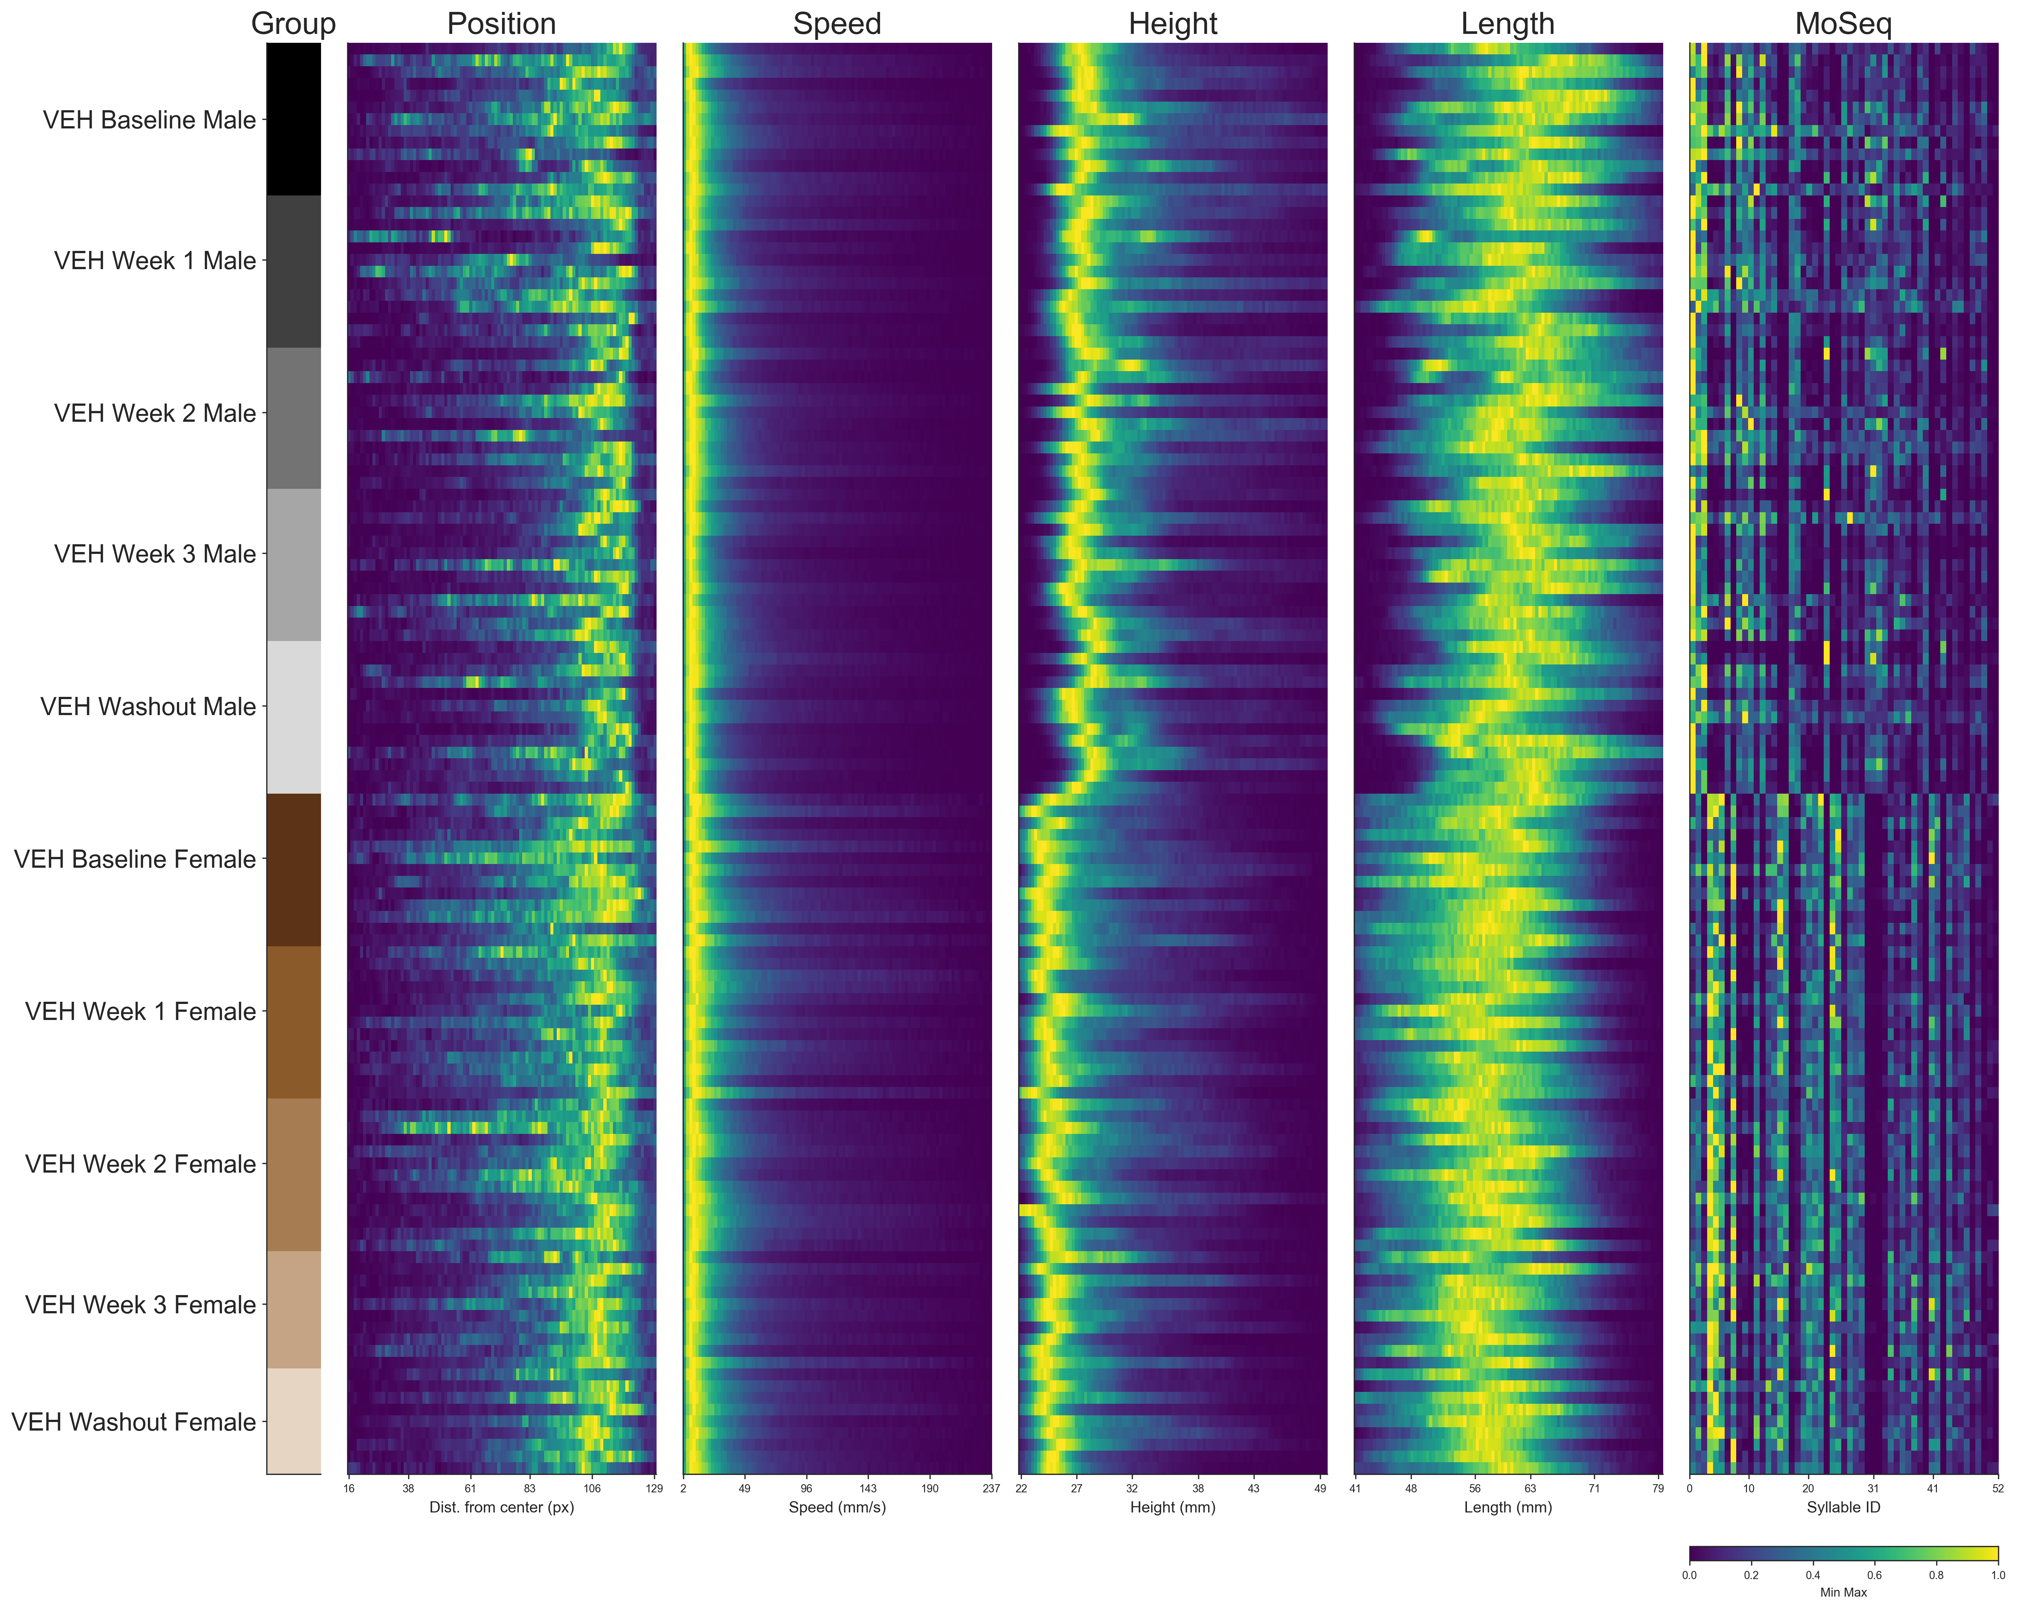

Slide 3
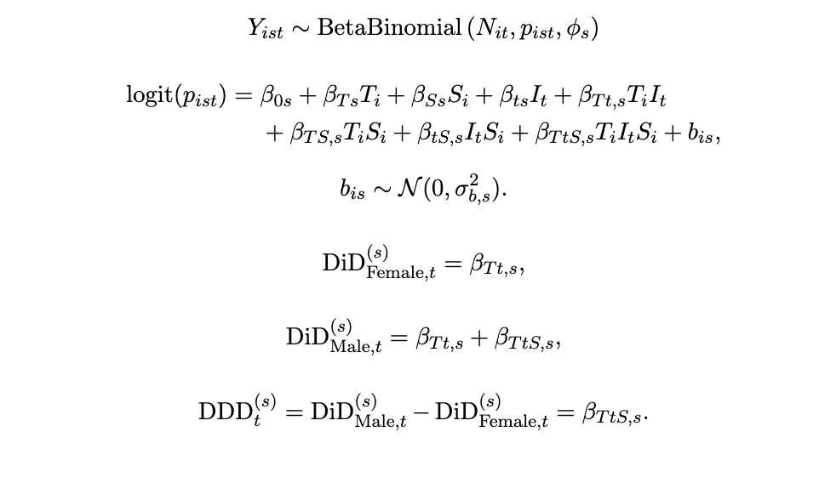
Proposed Statistical Test on CORT treatment significance
(currently communicating with Professor Yu)
Use a mixed effect Model instead of Anova/t-test to account for correlated data (repeated measures on same set of mice over time)
Use Difference in Difference (DID) method to measure the effect of CORT treatment on every syllable, and use Difference in Difference in Difference (DDD) to measure sex difference
Interpretation: DID_female_washout = (Cort_female_washout – Cort_female_baseline) - (Veh_female_washout – Veh_female_baseline)

Slide 4
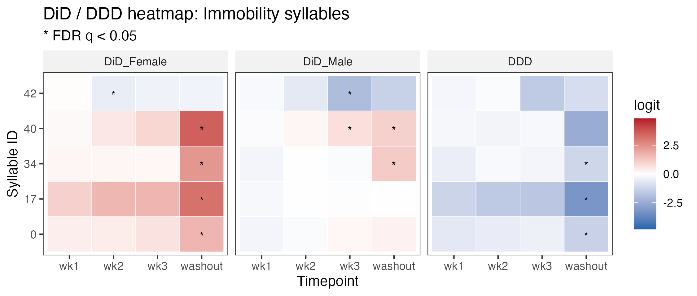
DDD = DID_male – DID_female

Slide 5
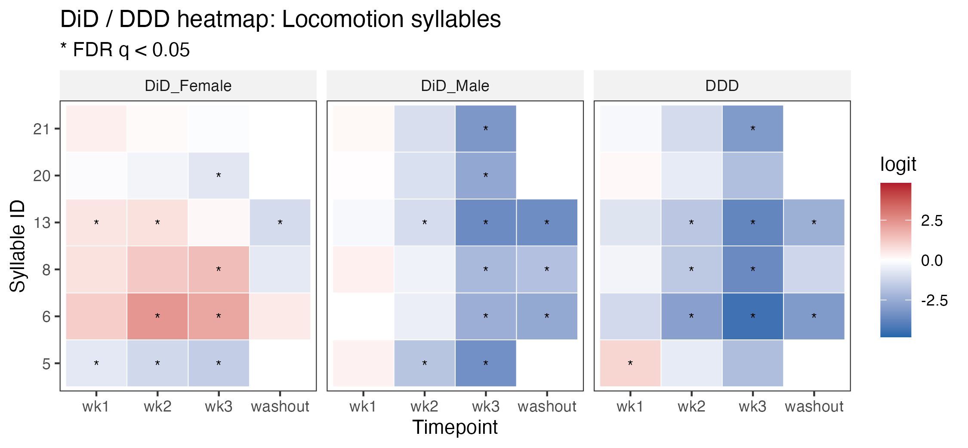

Slide 6
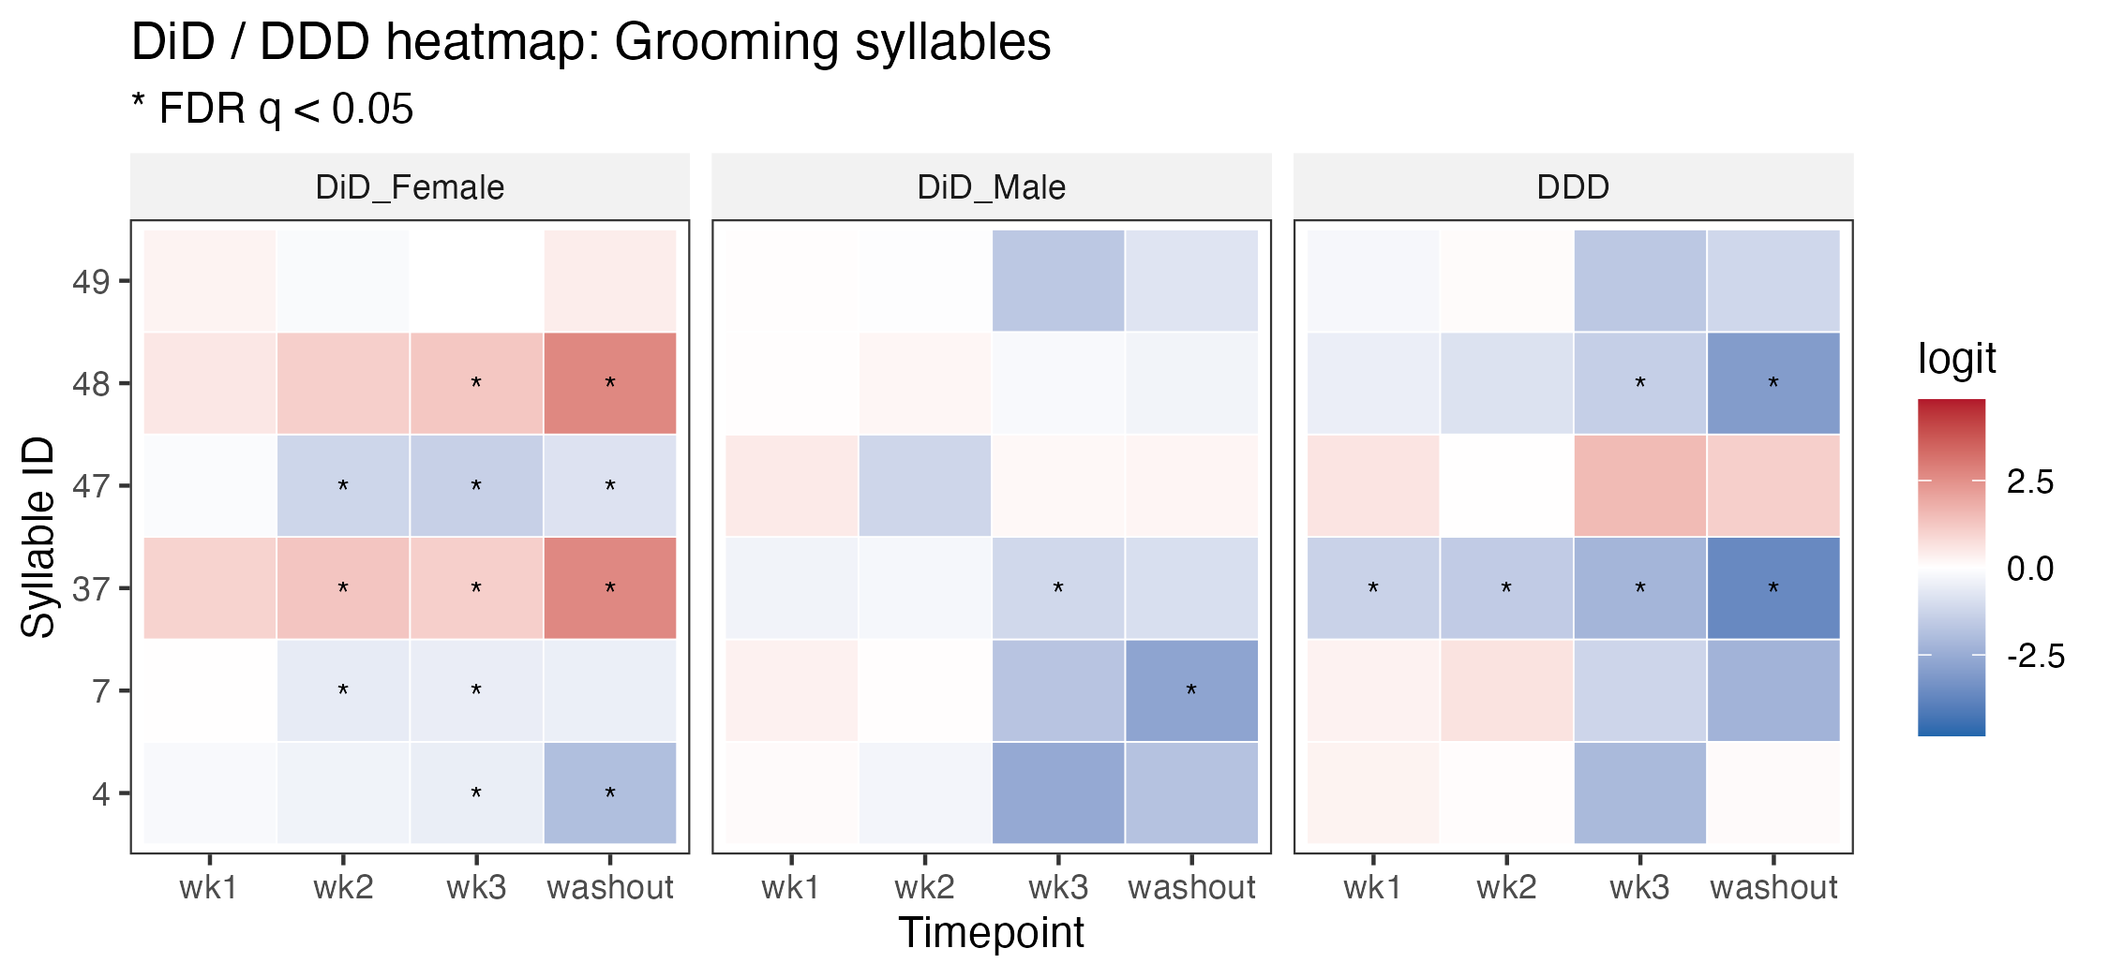

Slide 7
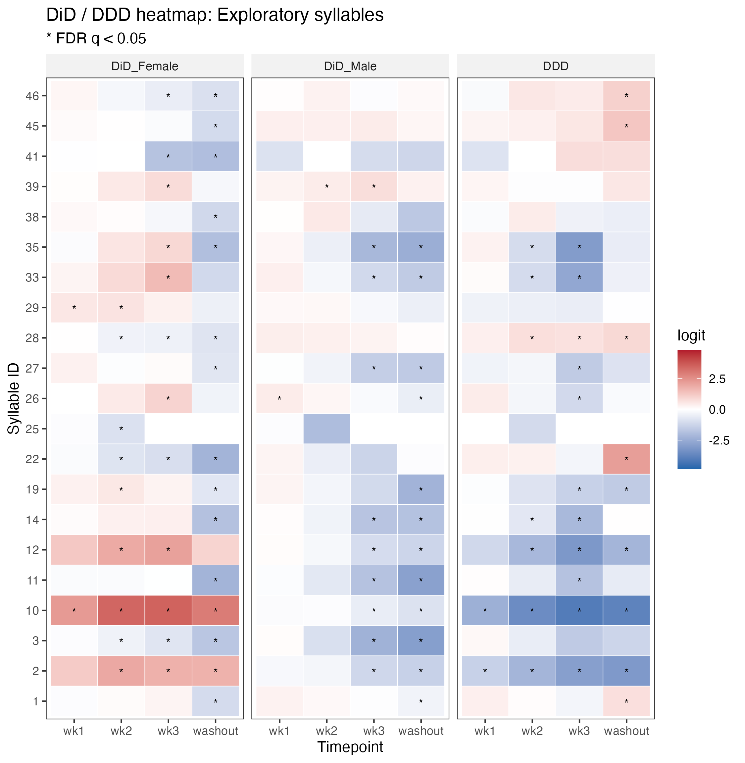

Slide 8
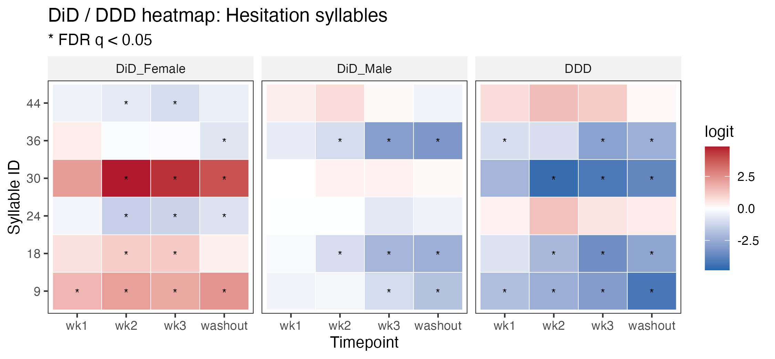

Slide 9
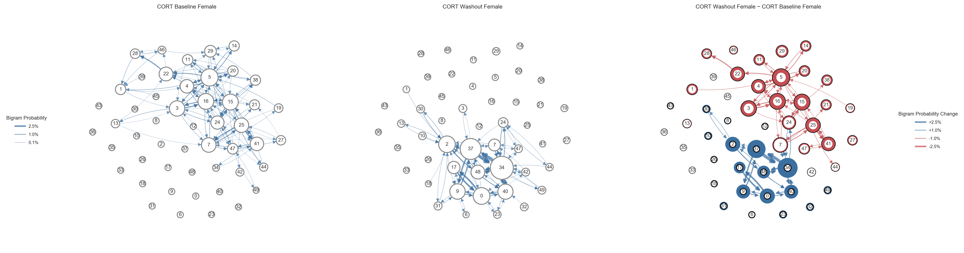
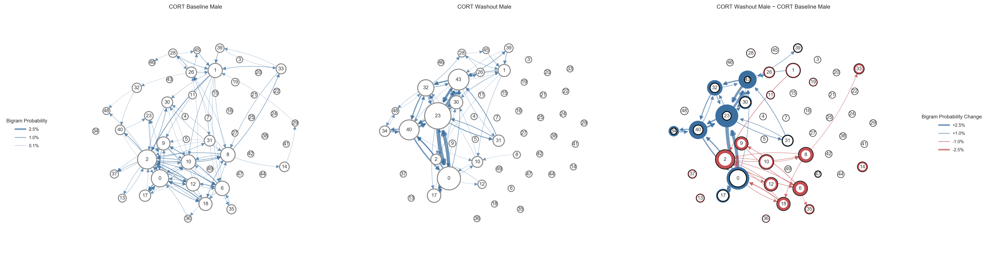

Slide 10
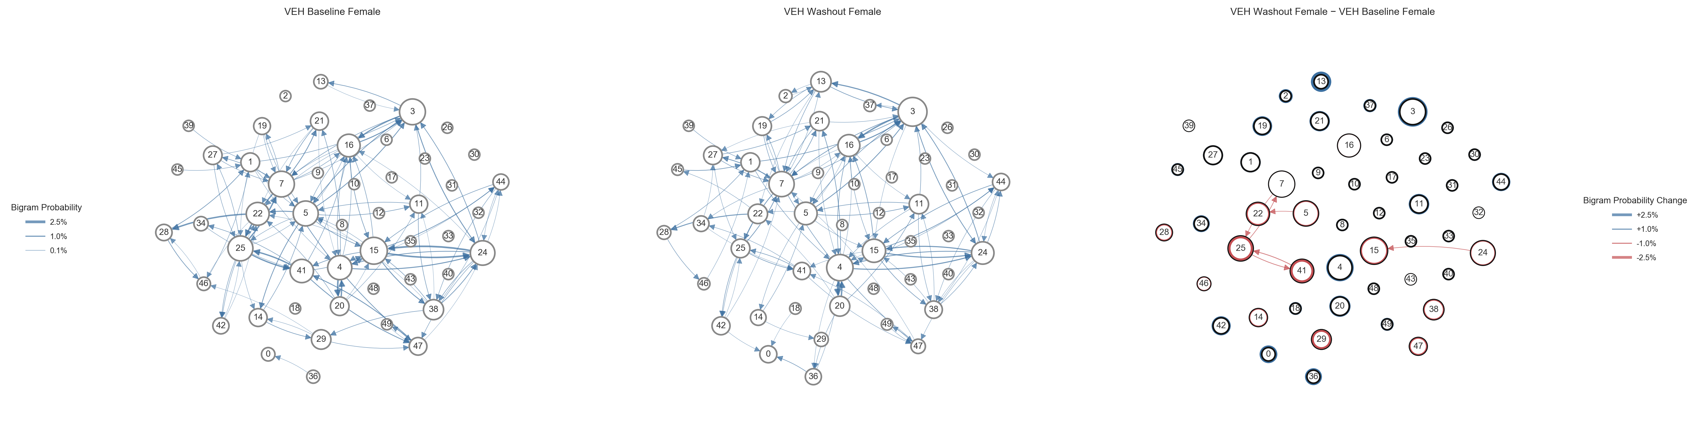
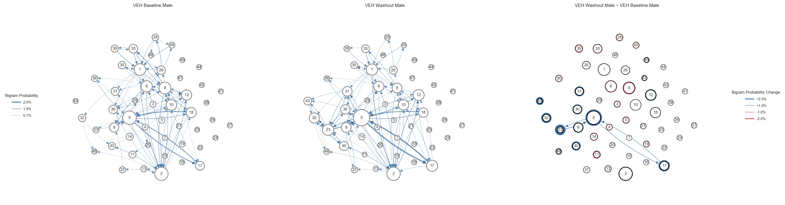

Slide 11
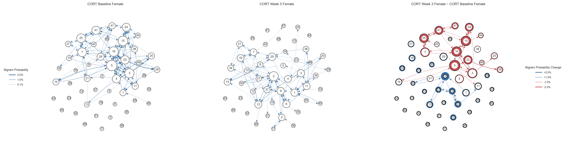
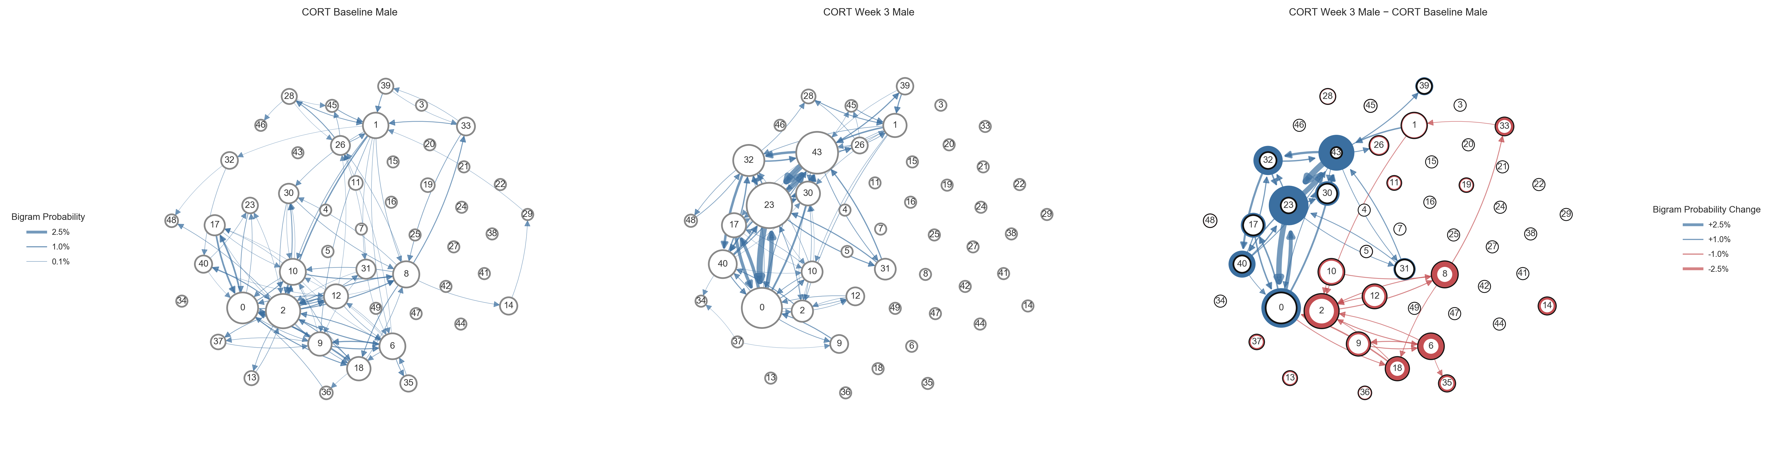

Slide 12
